Slide 1


Spatial Craftsmanship
Learn to Build Custom Solutions in ArcGIS Pro

Slide 2
What does it mean to “Build a tool”
We’re not creating an entirely new geoprocessing tool,
We’re tying existing tools together to make things go faster!
But why?
Standardize workflows in your organization
Automate data processing
Workflow sharing

Slide 3
Scenario
Your worst nightmare has reared its ugly head for the first time since 2019… You are assigned to convert waypoints collected from the field using Garmin GPS units equipped with IronSights into something that SARCOP can read. You also are told that several teams are out collecting data with the same system and will be bringing you the data several times over the next few days

Slide 4
How do we usually do this?
Determine Needed fields: Symbols, Team name, Squad ID
Create Geodatabase
Run GPX to Point tool
Add & calculate Team Name field
Add & calculate Squad ID field
Python/Arcade/SQL expression to calculate Symbols
Append data to Feature Layer

Slide 5
Ways to create these tools
Modelbuilder
Beginner friendly
Diagram driven
Great backend functionality, Front-end can be challenging
Great for quickly tying tools together
Handles intermediate data automatically
Custom Python Script Tool
Programming know-how required (Specifically ArcPy)
Easier to scale up to include tasks beyond GIS
Skills can be applied across ArcGIS suite

Slide 6
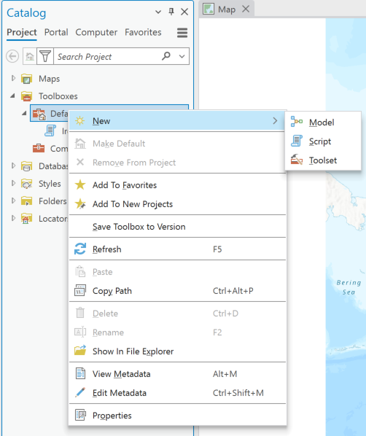
Modelbuilder
Open an APRX and go into the catalog. Then open Toolboxes, then right-click on a toolbox and select “New Model” to create a new model
The model should open by default. If not, right-click on the model and click Edit
See the full documentation for Modelbuilder here: Esri Documentation link

Slide 7
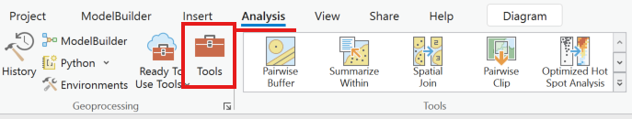
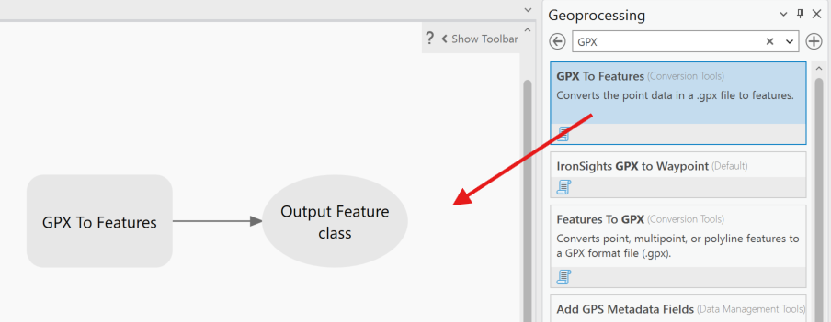
With the model open, go to the Analysis tab and open Tools
Search for GPX to Features. Before opening the tool, click and hold on the tool, then drag it into the model. This will add the tool into your model

Slide 8
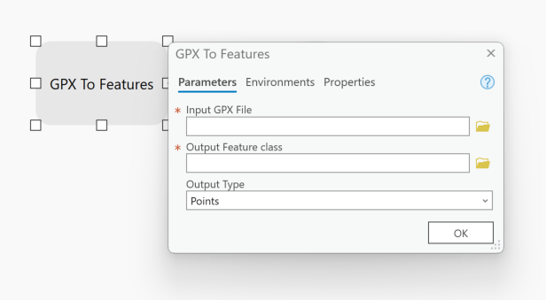
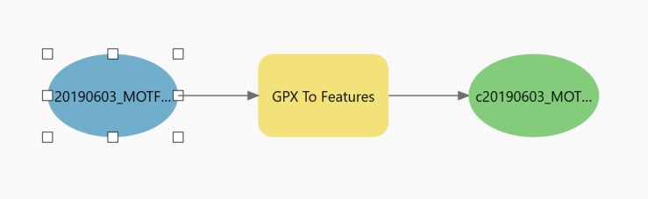
To edit the tool’s parameters, double-click on the GPX to Features box. This will look like the parameters you would see when you open the tool in the geoprocessing pane. Clicking OK does not run the tool in this case
If you fill in the parameters, the tool will change color, signifying that the tool’s parameters are met. Other branches will also appear (based on the tool) to signify input variables (such as the input GPX file)
TOOLS
VARIABLES

Slide 9
Variables can take three forms:
1. Constant parameters are defined parameters that only change in the Model Editor
2. User defined Parameters sport a P in the top right and will appear as a User Input parameter when the model is ran using the Geoprocessing pane
3. Output displays the output of the tool (such as a feature class)
VARIABLES
Constant Parameters
P
User Defined Parameters
Output

Slide 10
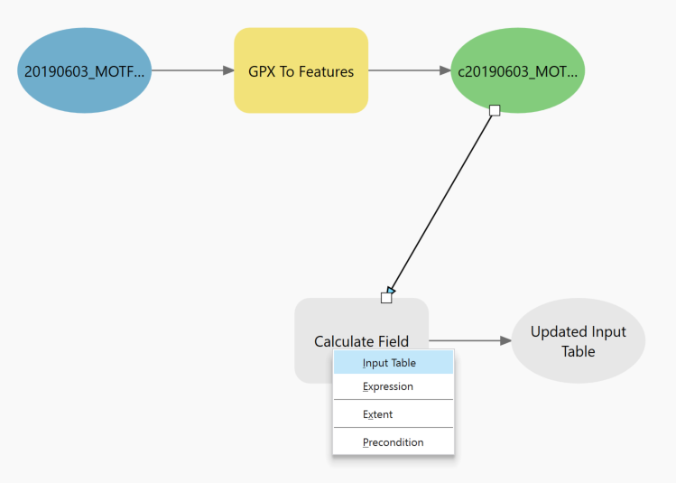
Search for the tool “Field Calculate” and drag it into your model. Then set it up to calculate a new field called “Team_Name”
When complete, click and hold on the output feature class of the GPX to Features (the green variable) and drag the arrow to the first Field calculate. Select Input table
Do this a second time using the Updated Input Table as the new feature class, connecting it to another field calculate in the same way. This connecting is how you can tie the tools together in Modelbuilder

Slide 11
Complete the same steps for a second field calculate tool, this time for Squad ID
Connect it to the last tool’s output feature class. See the next slide for a diagram of what the tool should look like now

Slide 12
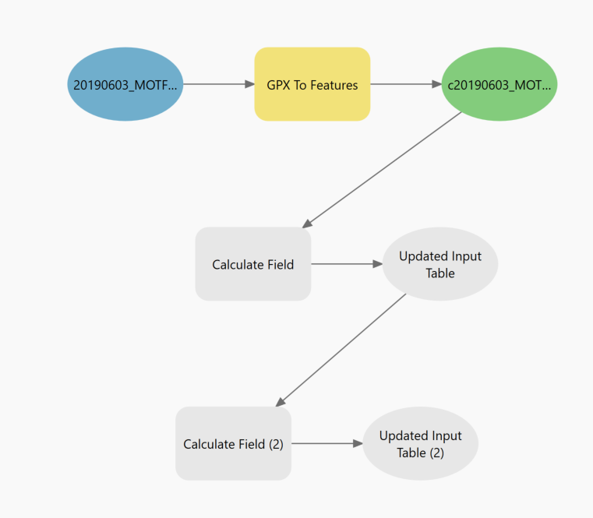
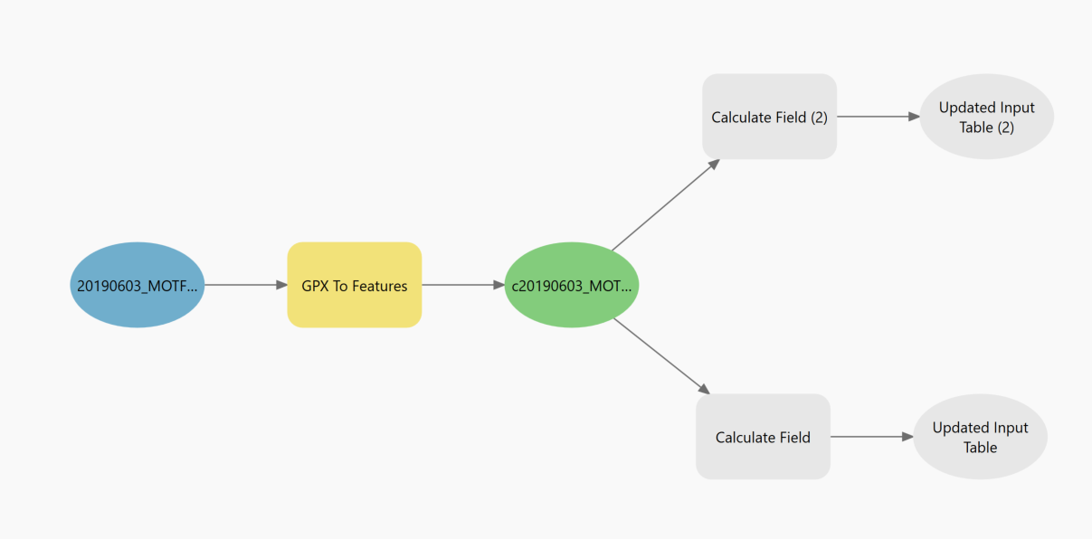
With the GPX to Features and two field calculates, your tool should look like one of the below. You can set up this step either way and the model will accomplish the same thing, but always keep in mind what steps are required for the tool and wire the model accordingly.

Slide 13
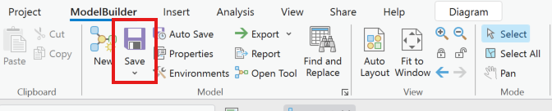
Remember to save!!

Slide 14
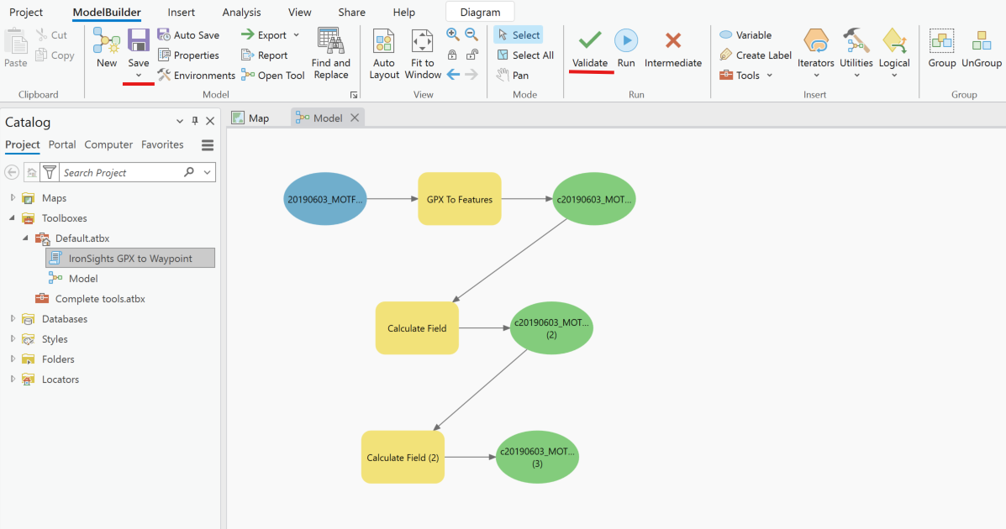
Double-click on the field calculate tools and fill out tools to make one create and calculate a team name, the other a Squad ID (if not done already)
Field calculate lets you create and calculate a new field in one step
When complete, the tool should be all colored in
Save the tool and click Validate in the Modelbuilder tab
Don’t worry if nothing happens when clicking Validate; this is to make sure everything is filled out. You do NOT need to click this to run the tool, but it’s good practice to run this to make sure your tool doesn’t throw any immediate errors.
When Ready, click Run next to the Validate button and watch the tool work. When done, go to the default geodatabase for your data output

Slide 15
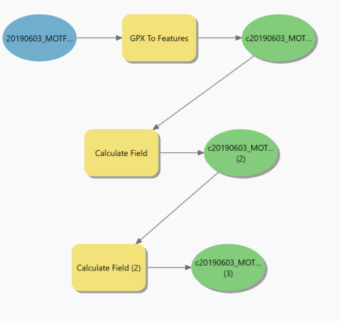
The tool that is currently running will be highlighted in Red , and a shadow will appear behind the variable and tool when it is successfully run. This is an example of the tool when it is complete
With all of this, the tool likely does not take any user inputs and will run with the user defined features. Next we will put in some parameters to change what files we run the tool with.

Slide 16
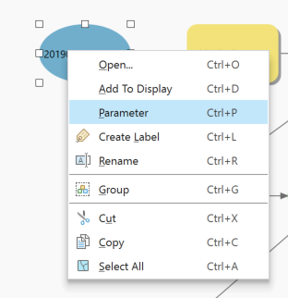
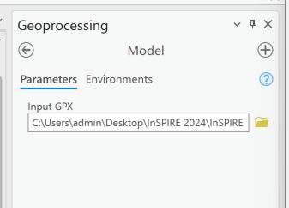
Let’s add in a user parameter now. Right-click on the input GPX variable and select Parameter
A small “P” will appear in the top right of the bubble, signifying that this is a use input parameter
After saving the model, double click on the model in the toolbox. This will open in the geoprocessing pane with all the user parameters you set (in this case so far just one – the input GPX)
Right-click on the variable oval within your model and click Rename. Whatever the variable name is changed to will change the name of the parameter in the Geoprocessing pane

Slide 17
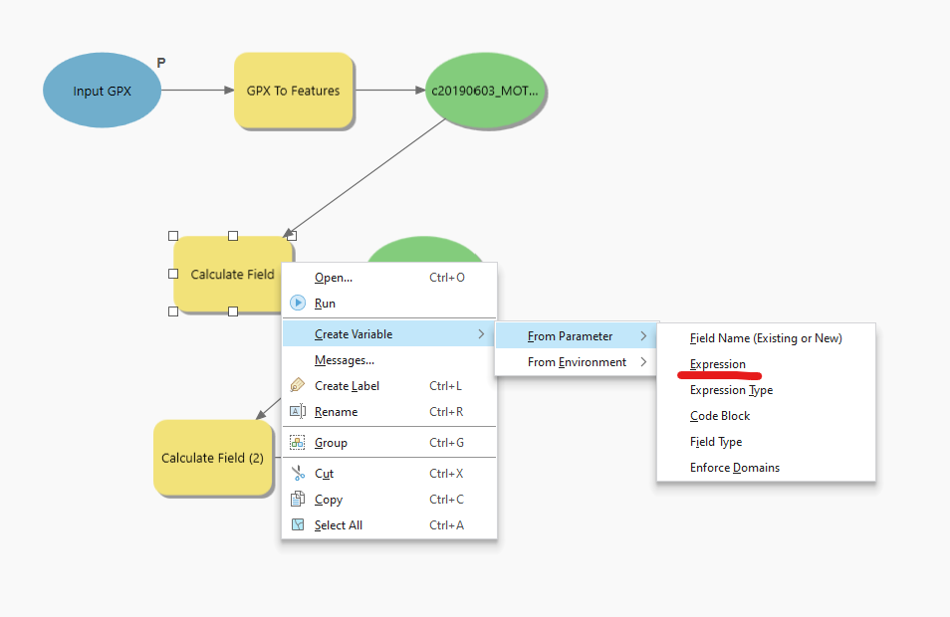
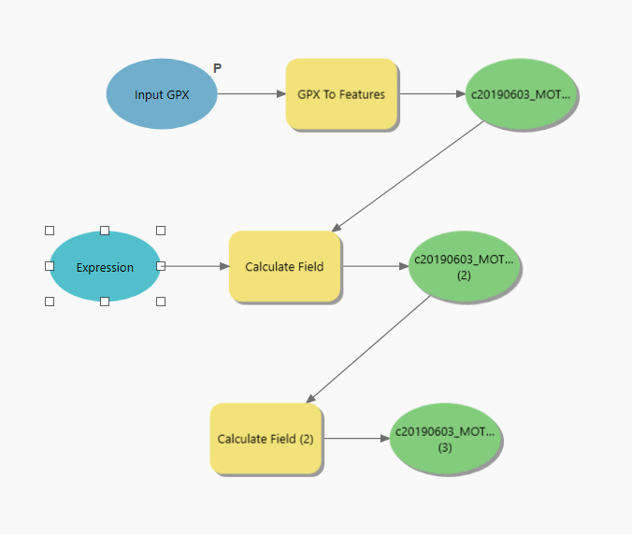
You can do the same thing on any tool by right clicking on the tool and selecting Create Variable > From Parameter, then choosing what parameter you would like as the user input. In this case we will make the Expression a parameter so it can be changed when the tool is ran in the geoprocessing pane

Slide 18
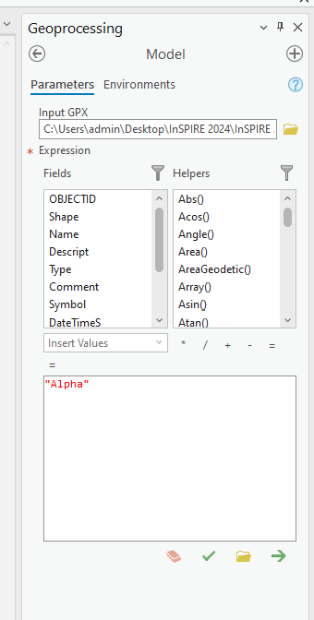
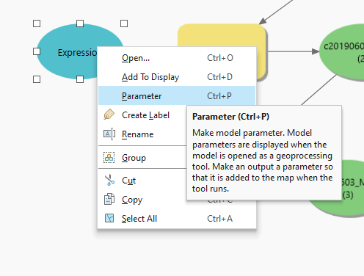
Like before, right-click on the new Expression variable and choose Parameter. Then save the model and try opening it in the Geoprocessing pane once again
This time you should notice that the whole field calculate expression appears. This is a limitation of Modelbuilder in that it is difficult to set up a simple text input

Slide 19
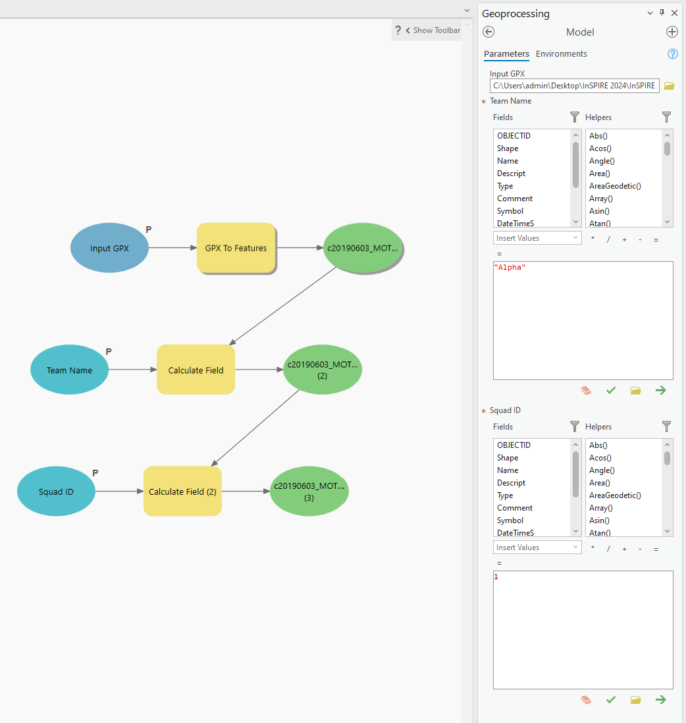
Rename the first Expression to “Team Name,” then repeat the last few steps to do the same for Squad ID. When complete your model and geoprocessing pane UI should look like this
Try running the tool with some provided test data, located in the InSPIRE 2024\InSPIRE 2024 Pro Project\example_data folder. Expored data should go to the Default geodatabase

Slide 20
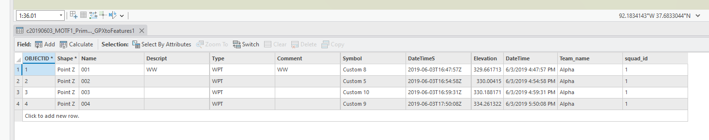
Examine the output data. You’ll notice that the features have been created and the Team Name and Squad ID fields have been added to the attributes, calculated to whatever you put in

Slide 21
Choose the output name and location
The last part this will cover is selecting the output location instead of going to the default. In the model, right-click on each current parameter and select Parameter once again. This will turn it off. Then select and re-enable parameters for each variable in the following order:
Input GPX
Output Feature Class
Team Name
Squad ID
This will change the variable order in the geoprocessing UI

Slide 22
Next step ideas
This tool covers a very basic GPX to features workflow. There are additional tasks that can be added on to make this production ready. Below are some ideas. Think about how you would tackle these problems and what tools you would use, then use what you learned to implement them into the model
Tracklog processing (feature ‘type’ is TWPT instead of WPT)
Symbol calculation (take the calculation from the Python section and implement it in the model)
Append data into another database or Feature Layer

Slide 23
Python and Arcpy
Building a geoprocessing tool with Python

Slide 24
Python terminology & key foundations
Libraries – modules of commands that can be brought in and utilized in Python
“Import” and library name are usually found at the top of the script
Any time you see the library name, it means it’s calling a specific command
Library is the building, command is the book
Arcpy, OS, Pandas, NumPy, and TKinter are popular and appear in my example scripts
Variables – Containers for storing data values, usually seen with an equal sign
Example: x = 1, x is the variable. Anywhere that X is accessed is where the number 1 is located
If the script was then print(x), the number 1 would be printed
Counting in programming starts at 0 instead of 1! This is important for parameters in ArcPy
IDE – Program to edit code
For demo, I am using the built-in script editor

Slide 25
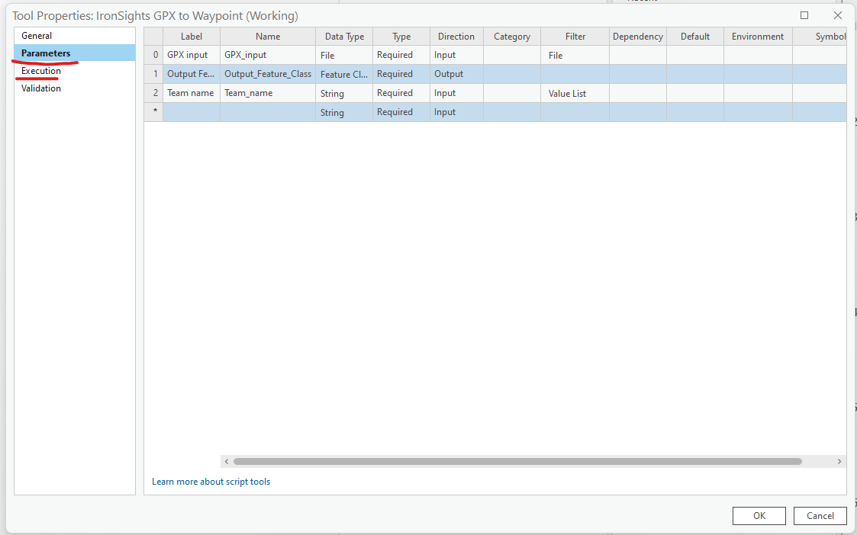
As part of the template, I set up part of the script to begin. It is located in the default toolbox called “IronSights GPX to Waypoint”. This script already brings in the library needed, has a few parameters set up already, and has the symbol calculation embedded in the tool.
Right-click on the script and click Properties. The “Parameters” and “Execution” sections are where we will be spending most of our time

Slide 26
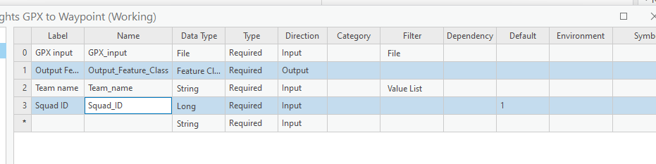
For this example, we will start with the parameters.
Like in Modelbuilder, Parameters are the user inputs in the tool that appear in the geoprocessing pane. In a Python tool, we have a lot more control over what the parameters look like
To add a parameter, click the empty row at the bottom of the table. Add a Squad ID field. Then set the Data Type to Long, and set the default to “1”

Slide 27
Open the Execution tab. I already added some parts to help with the development.
Take a second to read through the script as it is. Lines with several “#” signs are comments, or lines that are not read by the script, effectively working as notes within the script
The script, and most other python scripts, are broken up into sections for easy reading and logical comprehension. They may not always be written out this way, but this is a good start. Writing comments through your script is always a good idea for both you and anyone who may be using your script in the future.
The next slide offers more information about each broken out section

Slide 28
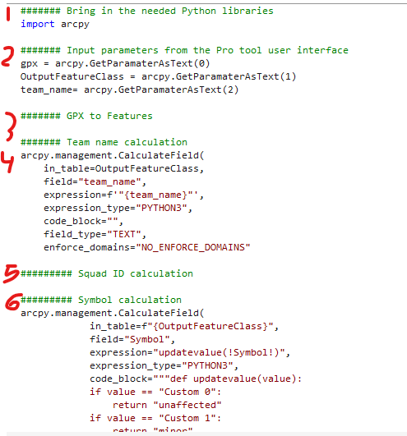
This section is where libraries are imported. They are almost always imported in at the beginning of the script
These are the parameters being brought into the script. The next slide will cover how the variables work and brought into the script
Placeholder for the GPX to Features tool
Field calculate tool for Team name. We will dive closer into how the tools are brought in in a later slide
Placeholder for the Squad ID calculation
Pre-build calculation for the symbol field
(Off screen) Adds newly created feature class to map

Slide 29
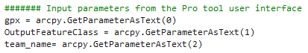
User Parameters
These are the user parameters being brought in from the UI within Pro into the script. These are examples of script variables
Arcpy.GetParameterAsText() is the most common variable type you will see with parameters in custom tools. The number in the paratheses indicates what parameter this variable is pulling from (0 being the first variable in the Parameters tables, 1 being the second, etc). This will pull in the parameter as a string. Now, throughout the script, any time you see the variable, you should know that that attached user parameter is being placed in that line
You can also use arcpy.GetParameter() if you are pulling a number or list

Slide 30
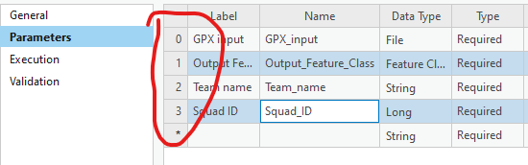
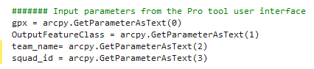
Easiest way to get the parameter number is from the parameters tab. Whatever parameter you are pulling, look at the number on the left side
Add a new parameter following the scheme in lines for Squad ID, then go back to the script and copy & paste the team name variable
Modify the variable to say “Squad_ID”
Your new parameter should be:
squad_id = arcpy.GetParameterAsText(3)

Slide 31
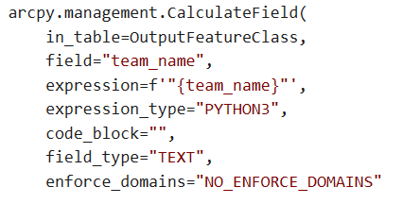
Tools
Tools are brought in from Pro using the ArcPy library. Looking over the tool, you can see that the variables are laid out similarly to how they would be if you opened the tool as is in the geoprocessing pane
Notice the input table is “OutputFeatureClass”. This is the parameter pulled in from line 6 OutputFeatureClass = arcpy.GetParamaterAsText(1)
Team_name is also pulled in, but MUST be brought in through the format process (see slides 43 and 44)

Slide 32
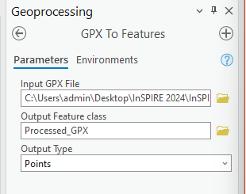
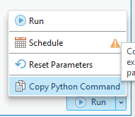
Adding new tools
You might think that adding new tools into the script is challenging, but Pro allows us to do it very easily. Click OK in the tool properties and open the GeoProcessing pane
Search for GPX to Features and fill out the tool UI as you usually would (You can find some example data in InSPIRE 2024 Pro Project\example_data folder)
Before you hit Run, click the dropdown arrow
Then select Copy Python Command

Slide 33
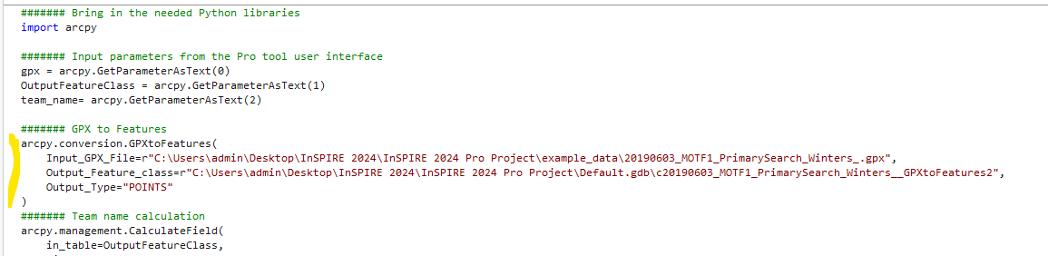
Return to the Execution tab of your script (toolbox – right click on the script – Properties – Execution)
Click under the GPX to Features comment and paste it into the Python command. This copies the python command plus the input parameters. To get the script to work for us, we will need to do some editing

Slide 34
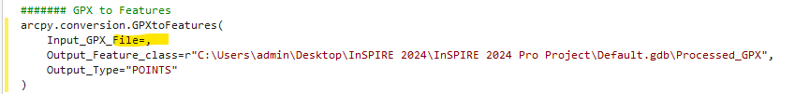
In the GPX to Features command, make the following changes:
1. Input_GPX_File line: remove everything between the equal sign and the first comma
Between the equal sign and the first comma, place “gpx”
Do the same for the next line called Output_Feature_class, changing it to “OutputFeatureClass”

Slide 35
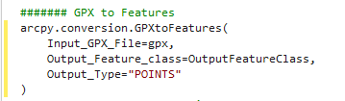
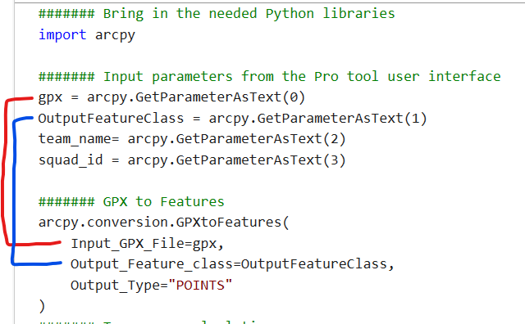
The command should look like this when done:
What we did was utilize the variables set earlier in the script and place them into the command’s parameters. This same thing can be done throughout the script

Slide 36
Running your new tool
Click OK when done editing. Then double-click on the script in the toolbox to open it in the geoprocessing pane.
Fill out the parameters of the tool using a sample GPX file. The rest of the parameters can be left as the default. Then click Run. When finished, find that new feature class in your default GDB and open the Attribute table
You may need to refresh the GDB
The features were created, the Symbol field was changed to match the SARCOP symbol code, and Team Name was calculated

Slide 37
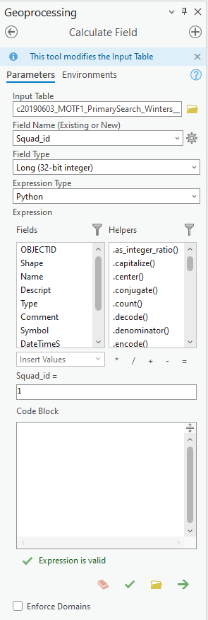
Another way to add commands
There are a few ways a tool command can be added to the script. The first way we already covered. The second way is through the geoprocessing history
First, head back to the geoprocessing pane and search for, then run a field calculation for Squad ID using the newly created feature class
This time, click run and let the tool finish

Slide 38
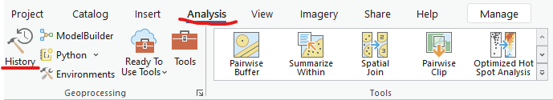
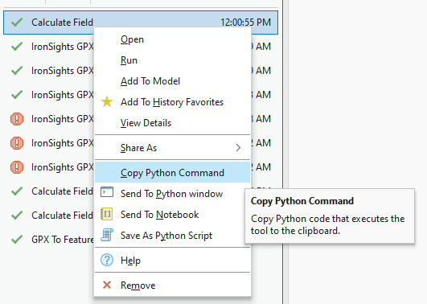
Another way to add commands
Go to Analysis and History on the far left
This opens the history of what tools you have ran in this project. Select and right-click on the latest Calculate Field, then chose the Copy Python Command option

Slide 39
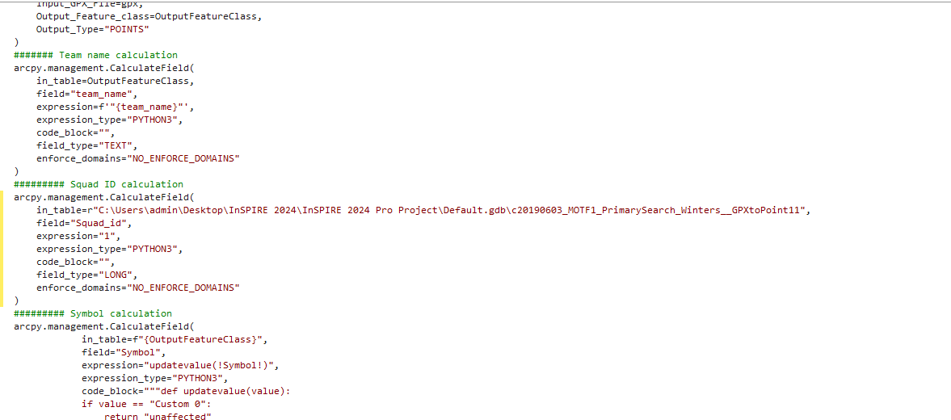
Like before, open the script’s Execution page. Find the Squad ID comment and paste in the python command

Slide 40
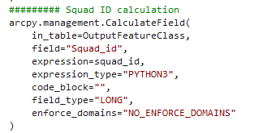
Change the in table and expression fields to “OutputFeatureClass” and “squad_id” respectively
Click OK and try running your tool once again
Make sure to keep the commas in the command. Removing these will make the script not work!
In this case because we are working with an integer, we do not have to have the nested quotes and F string formatting in the experssion

Slide 41
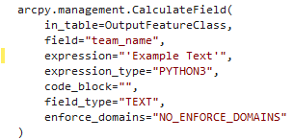
Calculate field - strings
You may notice the expression is different between the Squad ID and Team Name. This is because Team name uses a string, while Squad ID uses an integer
Like in regular Field Calculate, you must have the entry in quotes to place in a string value. The same rule applies here, meaning the expression must be in two sets of quotes

Slide 42
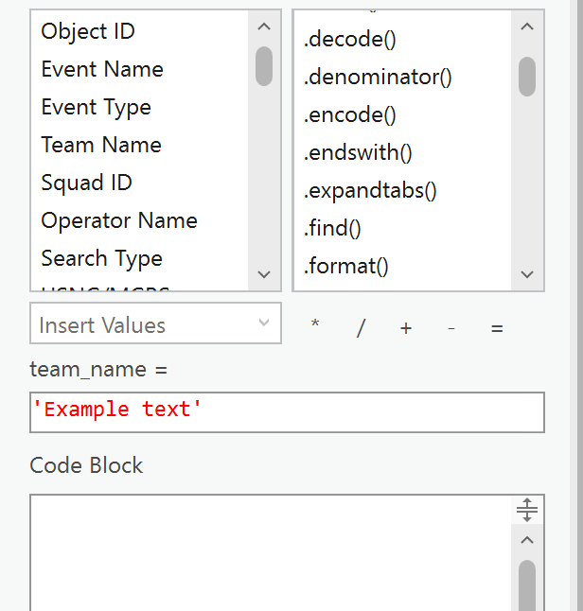
Calculate field - strings
Just like in the regular calculate field, a string must be in quotes in the expression

Slide 43
Format strings
In our script, we also use the “format string” (f string in this case) function in Python to plug in our variable
Format strings allow us to insert a variable into an existing string without breaking the string. Placing a “f” before the string and {} where we want the variable to go
Example:
X = “World”
print(f“Hello {x}”)
Output:
Hello World
More about F strings here https://www.geeksforgeeks.org/formatted-string-literals-f-strings-python/#

Slide 44
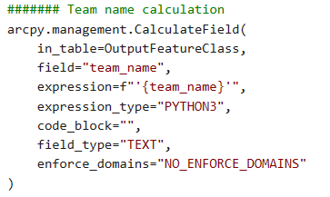
Format strings
In our script, Team Name is set up as a F string so that it can intake whatever string is chosen, therefore the command looks like:

Slide 45
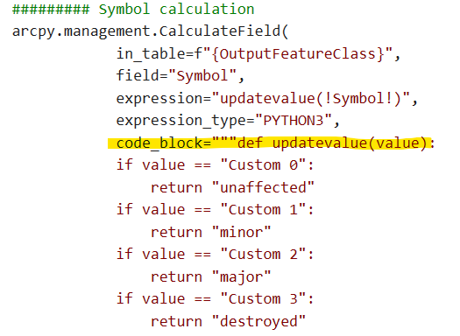
A similar setup is used when you have an expression block in a calculate field command. Notice how the function is set into several sets of quotes
The best way to work with a calculate field that requires a code block is to set it up in the Calculate Field tool in the geoprocessing pane, then remove the whole command and replace it any time you need to make changes to it

Slide 46
Raw String
These look like:
Path = r’C\users\admin\Documents\file.txt’
Distinguished by the letter “r” in front of the string, similar to the F string
Ignore Escape Character Sequences
Reads the string “as is”
Without it, file paths would be read incorrectly since they use forward slashes as they are commonly used for text formatting
Print(r”C:\Users\admin\Documents”) will print correctly.
Print(”C:\Users\admin\Documents”) will throw an error

Slide 47
Automatically add data to the map
project = arcpy.mp.ArcGISProject("Current")
m = project.activeMap
m.addDataFromPath(OutputFeatureClass)
Add these three lines at the bottom of your script to add the data to your current map
These lines are available at the bottom of the provided script

Slide 48
Messages & Errors
Sometimes it is appropriate to add in messages to help you understand where your script is at, add messages to help debug, or cause the script to fail on purpose with a more helpful error message.
Arcpy.AddMessage() – Adds a general message in the geoprocessing pane while the tool is running
Arcpy.AddWarning() – Makes the tool throw a yellow message when tool is finished running
Arcpy.AddError() – Makes tool run a red message when tool is finished
Arcpy. SetProgressorLabel() – Adds a label in the processor to tell the user what step the tool is at

Slide 49
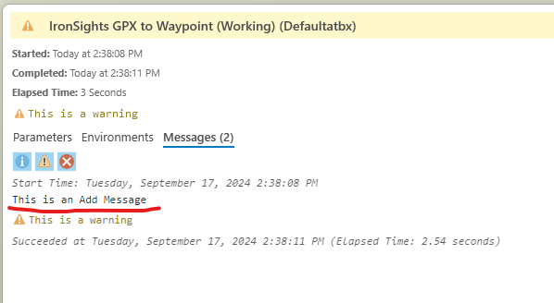
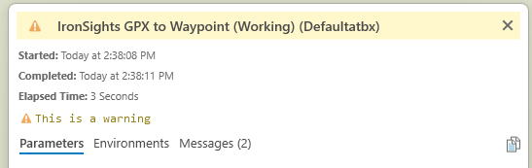
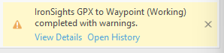
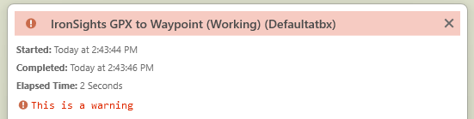
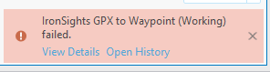
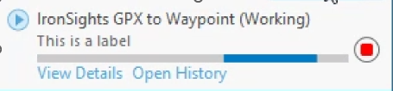
Messages & Errors
Arcpy.AddMessage()
Arcpy.AddWarning()
Arcpy.AddError()
Arcpy.SetProgressorLabel()

Slide 50
Resources
W3 schools – python tutorials and samples
Python courses by freeCodeCamp.org online and on YouTube
Advanced Python Scripting for ArcGIS Pro by Paul A. Zandbergen – Awesome book I used frequently

Slide 51
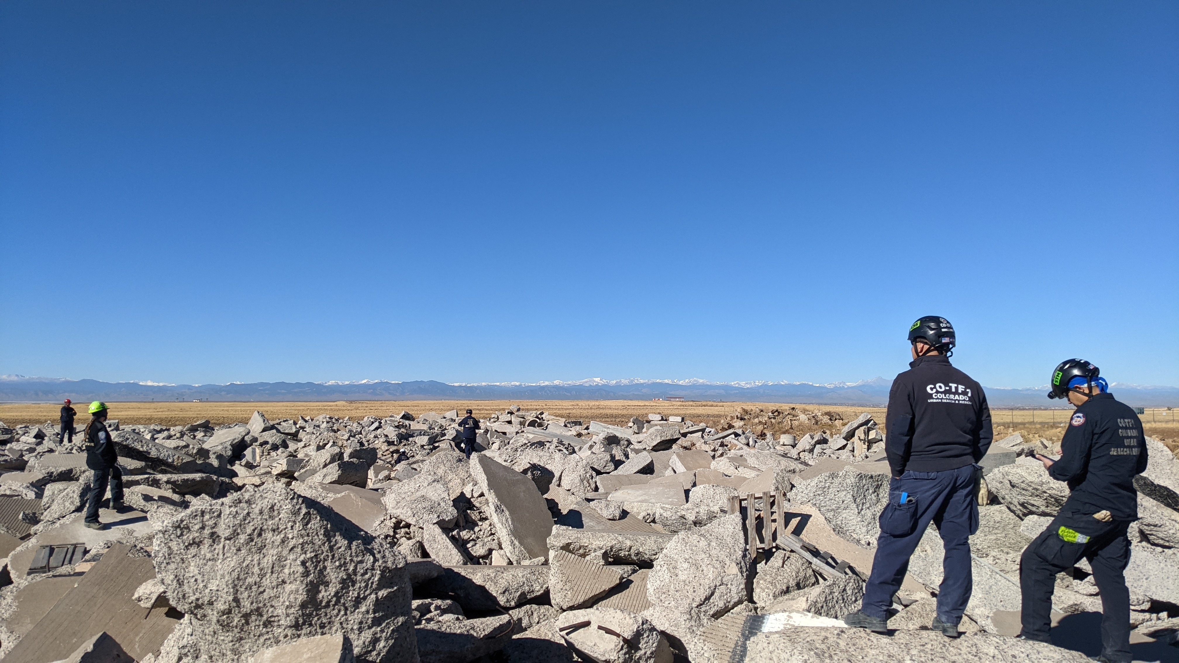
THANKS!
afackler@publicsafetygis.org
napsgfoundation.org
@napsgfoundation

